Slide 1
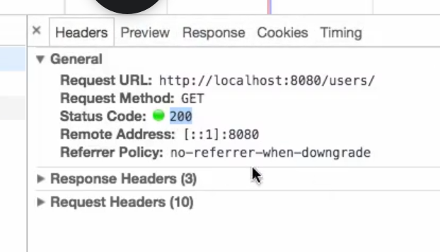
Status Codes
200 represents success GET request.

Slide 2
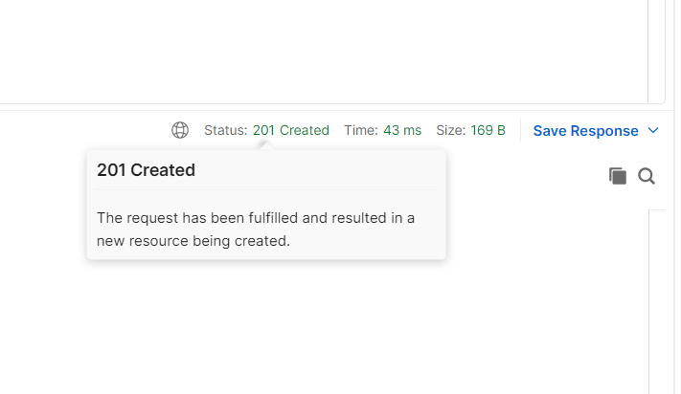
2.Created
This response is generated by a POST request
A new resource is been created when we get this response

Slide 3
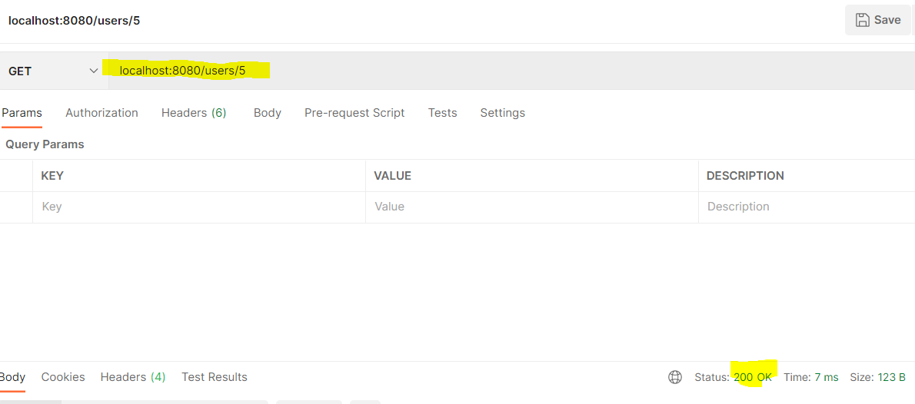
Now lets suppose I call a get request for a resource which is not present ,now I still get 200 http response, which is not correct. We should actually get a resource not found exception here.

Slide 4
Error 500(internal server error) vs 404
If any RuntimeException occurs during calling any API , a server by default throws 500 internal Server error
Therefore, if we are unable to find any resource in server, it will by default throw 500 internal server error
To avoid this, we create a custom exception and Annotate the exception class with @ResponseStatus(HttpStatus.NOT_FOUND) so that we may get 404 error instead.

Slide 5
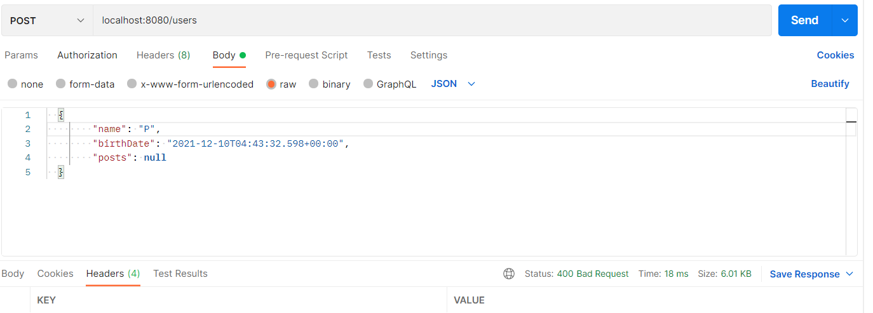
400 bad request
This error code comes when we add “Validations” to our bean.

